Slide 2
Overview
Since 2003 Innové has delivered knowledge and technical solutions that go beyond for innovation impact. And, the driving force of our success is our people. Together we are committed to a singular purpose – Sustainable Knowledge through Technology
Cyber Security – Applied risk management to agile, continuous development and DEVSECOPS
Learning – Comprehensive process driven training solutions; live, virtual & constructive
Software – Secure data-driven apps for work augmentation, automation and decision support
Professional Services – Trusted performance of project management, systems engineering, integration, test & sustainment
Our mission is to deliver knowledge and technology beyond expectations for customer success. We deliver on this mission using ISO 9001:2105 and CMMI Software Development best practices in identifying specific Government & Commercial client problems and building tech-driven solutions to specific need.

Slide 3
Partnership & Delivery Ecosystem
www.Innové.com

Slide 4
Innovation Impact | Int’l Development
Emerging Market Small Plot Farmers Through Programs Like USAID’s, “Feed the Future”

Slide 5
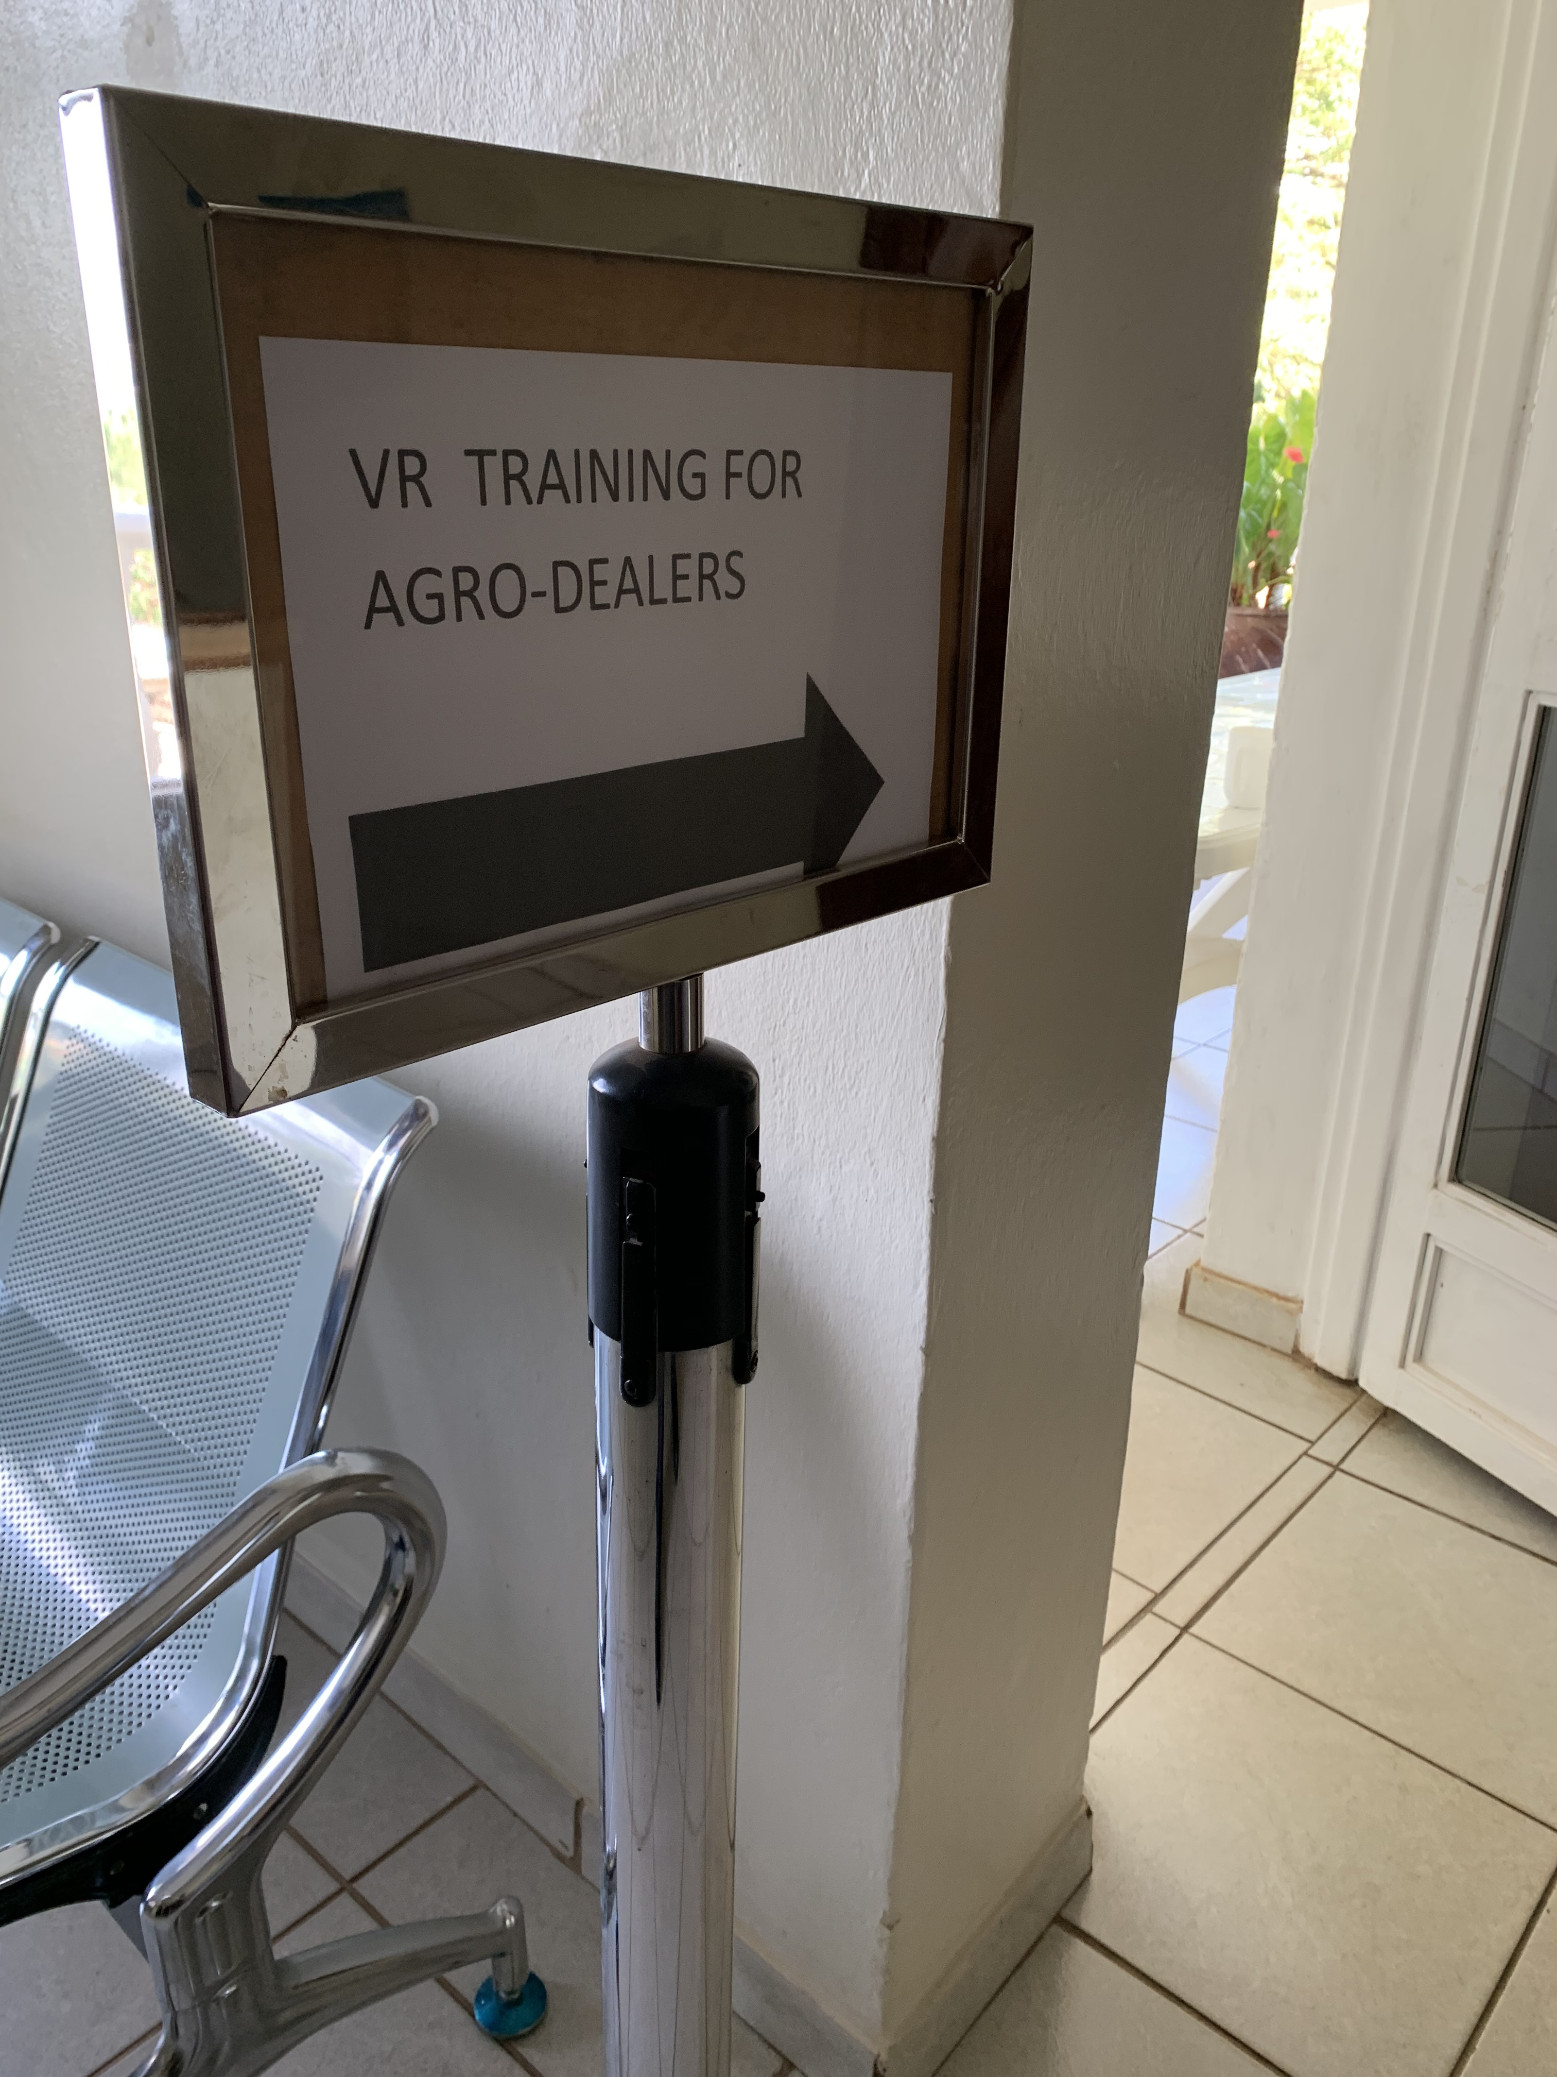
Innovation Impact | Int’l Development
Innové provided Africa’s first VR Agriculture Input Training…

Slide 6
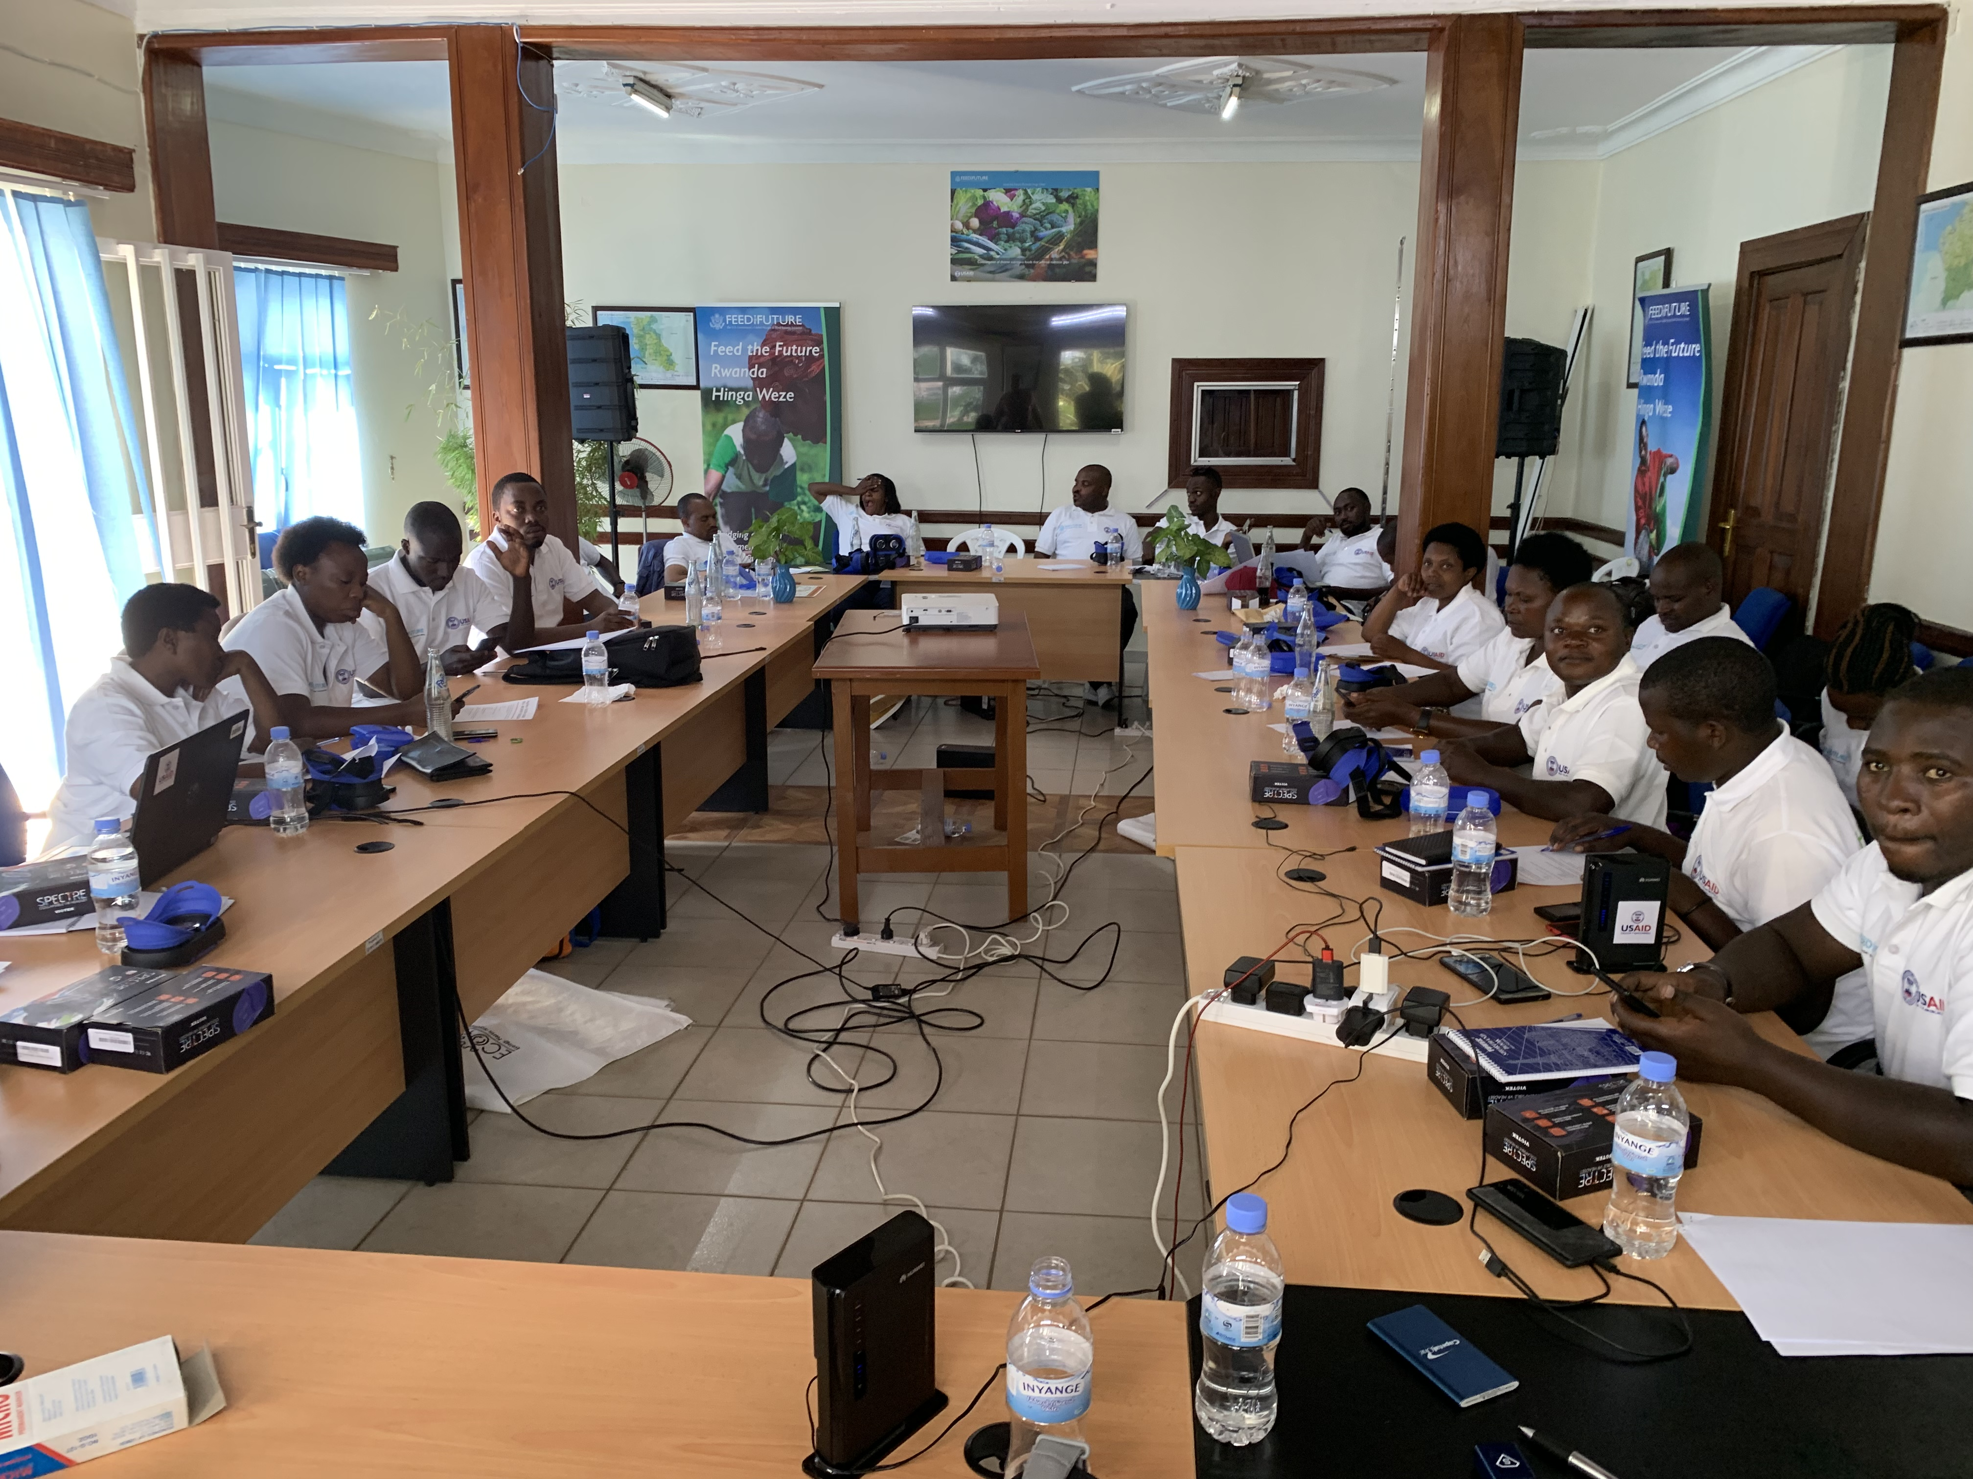
Innovation Impact | Int’l Development

Slide 7
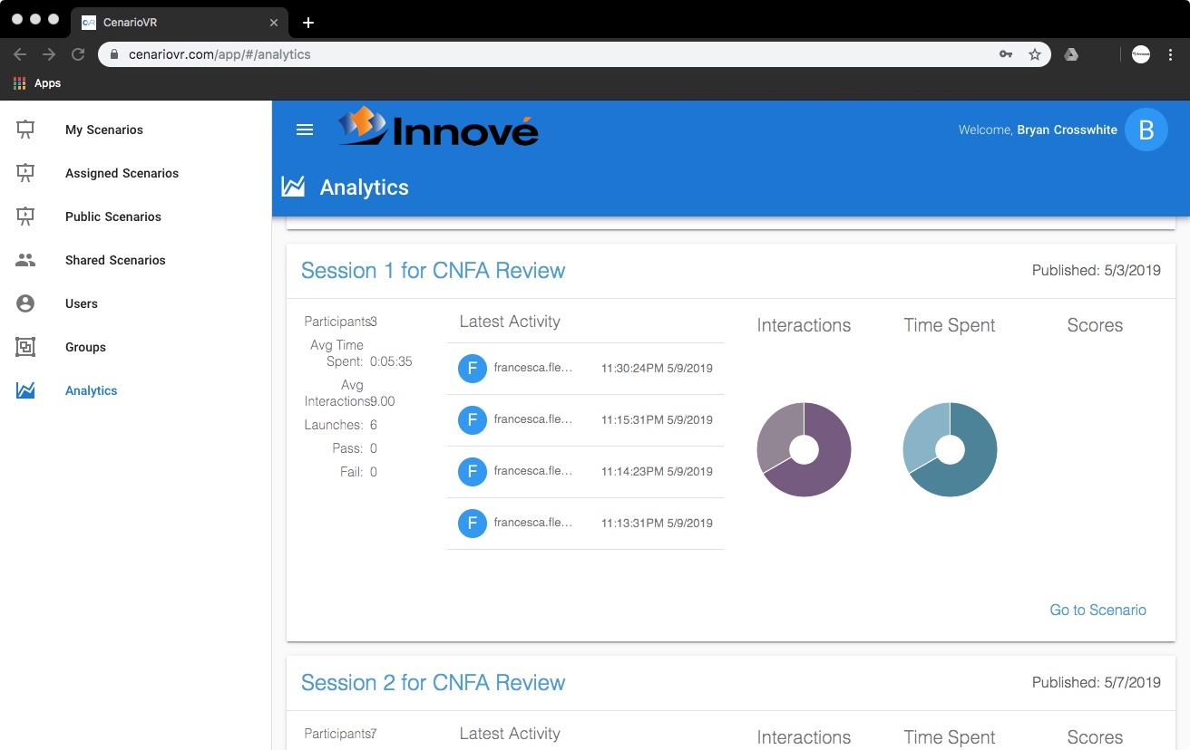
Innovation Impact | Int’l Development

Slide 8
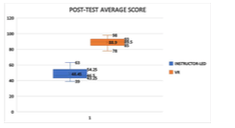
Traditional Training vs VR Training
43.25%
AGRICULTURE
48.45%
88.90%

Slide 9
Global Mission
Use Advance Technology to increase Food Security & Sustainability to the next Generation
Advance Gender Produced Products
Education within Youth Empowerment Programs

Slide 10
VR Emersion Training

Slide 11
Promotion of Woman Grown Products

Slide 12
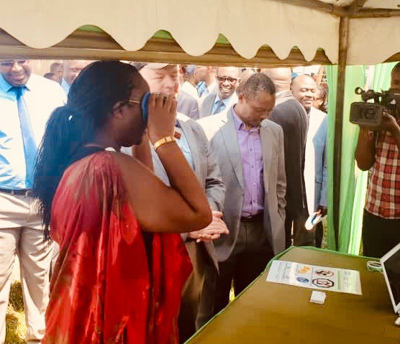
Government Stakeholder
Local Solutions for Global Problems
Co-developing solutions to meet National challenges
Providing ITC solutions for Imports and Exports
Agriculture Minister of Rwanda

Slide 13
Proven Agro Dealer / Extension Model
Fert.
Pest.
Seed
Farm Equip
Sales
Micro Finance
AGRICULTURE
Agriculture Input/Dealer
(One Stop Shop)
Loyalty
Card
Farmer Extension
ICT
Bank
Post Harvest
Contract
Mobile Ordering
Inventory Mgt
VR Training
Harvest Projection

Slide 14
Innové Agricultural Consulting Team
Mike Espy – Former US Secretary of Agriculture
Davit Kirvalidze – Former Minister of Agriculture of Georgia
Innocent Musabyimana – Former Perm. Secretary of Agriculture Rwanda
Doug Keesling – US Agricultural Advisory Committee
Dan Folta - Technical Advisor at Ministry of Agriculture Rwanda (Irrigation)
Brad Morrison – Development of Water Wells throughout Uganda
Bryan Crosswhite – Economist and Trade Policy Expert
Jeremy Kenisky – VR/AR Expert, Professor: University of the Incarnate Word
AGRICULTURE

Slide 15
Company Contacts
Mr. Bryan Crosswhite, VP, International Development
+1.830.469.8921
Bryan.Crosswhite@innove.com
Mr. Doug Keesling, VP, of Agriculture
+1.620.257.8125
Doug.Keesling@innove.com
www.Innové.com

